Slide 1
Microprocessors and Microcontrollers
CSE 315
Md. Iftekharul Islam Sakib

Slide 2
Needed Softwares
AVR Studio
https://www.microchip.com/mplab/avr-support/atmel-studio-7
Atmel Studio 7.0 (build 1931) offline installer
This is the IDE

Slide 3
Burner
Extreme Burner
http://extreme-burner-avr.software.informer.com/download/
There is also avrpal
Loads the HEX file into microcontroller

Slide 4
Needed Equipments
Microcontroller – ATmega32
The AVR Programmer / Loader
To load your code into the mc

Slide 5
Writing Code
Create New Project
Select “GCC C Executable Project”
Select path to save the project
You will later need this path for the hex file
Then select device type
Search for ATmega 32
Now you can write the program

Slide 6
Compile the hex code
Finish the program
Select “Build Solution (F7)” from the Build Menu
You will find that a hex file is generated in the Debug folder
The name of the hex file will be the same as your project name

Slide 7
Load the hex into mc
Run Extreme Burner
Load the hex file into it by “Open” and locate your hex file
From menu select Chip -> ATmega32
Set the microcontroller on the AVR Programmer
Connect the programmer with PC
In extreme Burner select the menu “write” and choose “Flash”

Slide 8
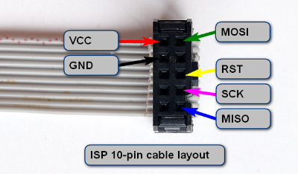
Connecting ATmega32 with programmer
Following the figure connect the 6 corresponding microcontroller pins with the loader.
Be careful about the orientation of the cable layout. The extended part goes to the right

Slide 9
Setting mc in the AVR Programmer (Not needed for you)
For the big loaders from TechshopBD
The upper portion (U) side goes closer to the side with the liver
There is a push button
Push it so that the yellow LED is on and the red one is off

Slide 10
Complete Process of Programming a Microcontroller
Write the code
In ATMEL Studio, or other IDE
Compile it to a .hex file.
For ATMEL Studio, you will find the hex on the “Debug” folder in your project

Slide 11
Complete Process of Programming a Microcontroller
3. Inserting the .hex file into the microcontroller
Load the hex file into burner
set the microcontroller on the “AVR Programmer”
Write
4. Set the microcontroller in the working circuit

Slide 12
☺

